Slide 1
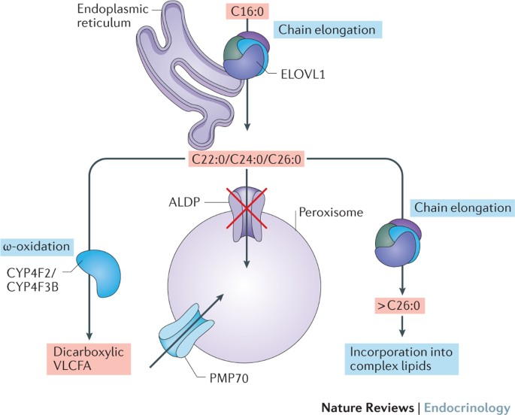
X-linked adrenoleukodystrophy (ALD)
The very long chains of fatty acids (VLCFAs)is therefore unable to be broken down due to the mutation of the ABCD1 gene.
VLCFAs build up in the brain, nervous system + adrenal glands as a result,
The accumulation is thought to cause inflammation + damage the myelin sheath.

Slide 2
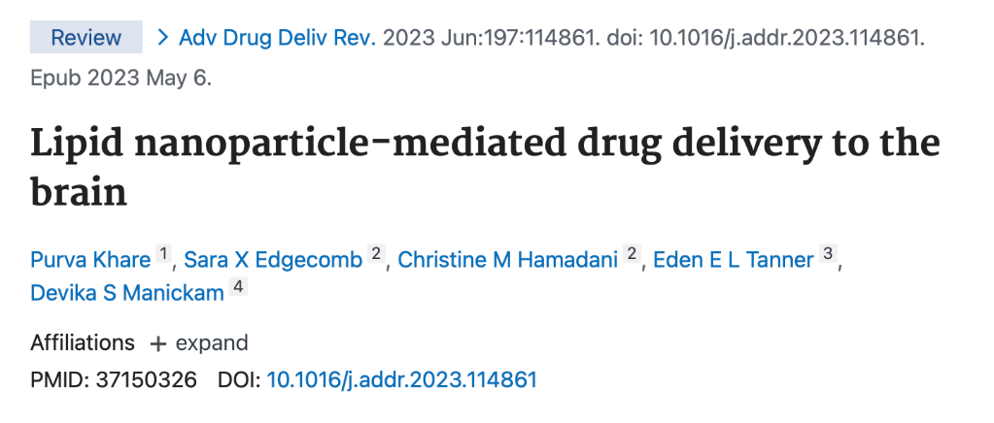
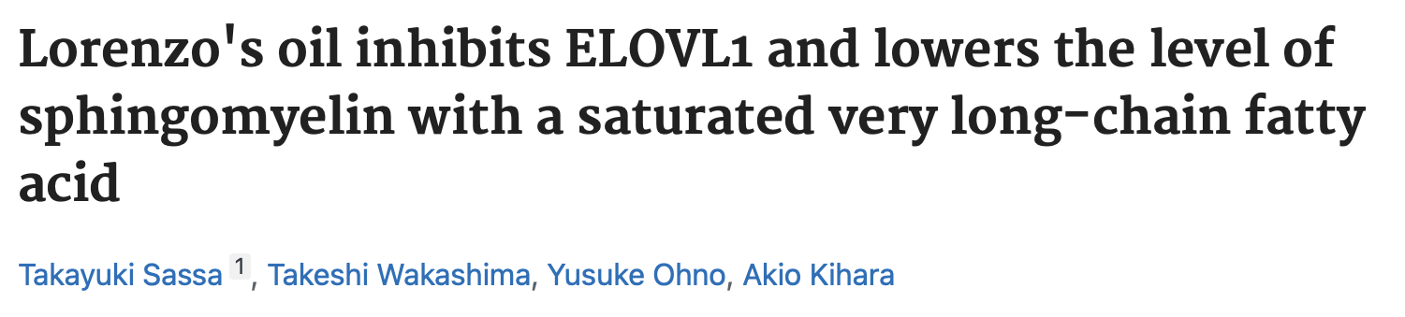
Relevant Literature

Slide 3
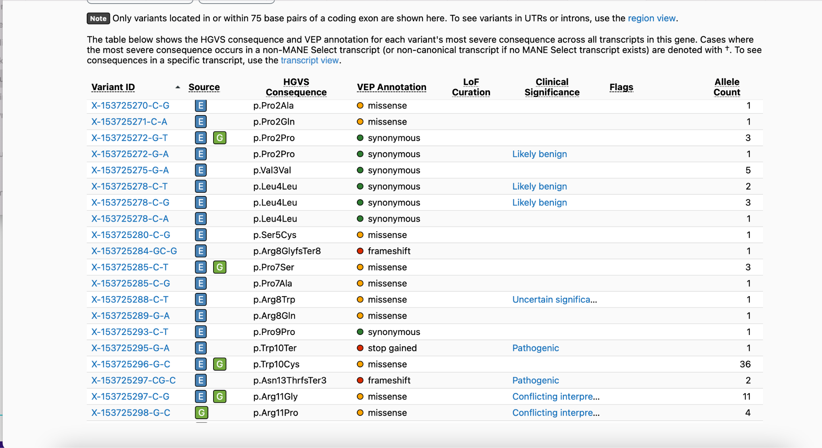
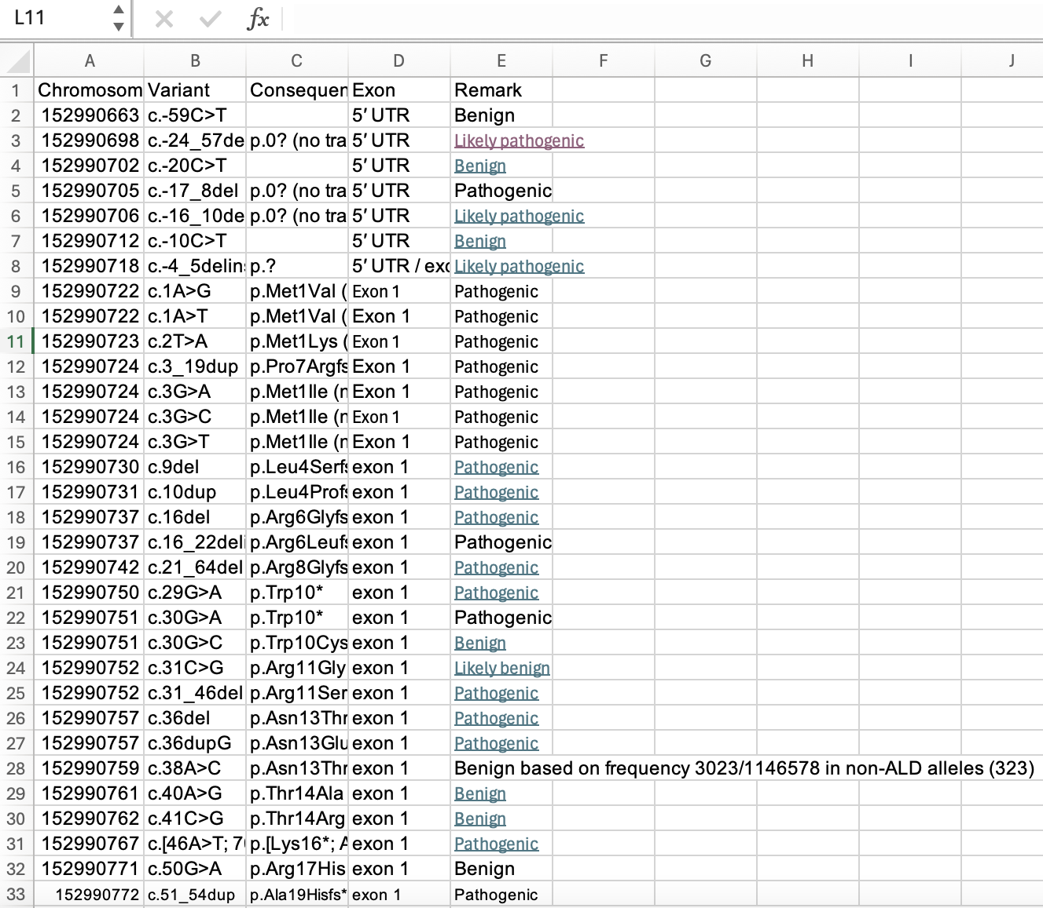
Data we worked with
Notes:
OMIM, Pubmed, + Science.org data referenced

Slide 4
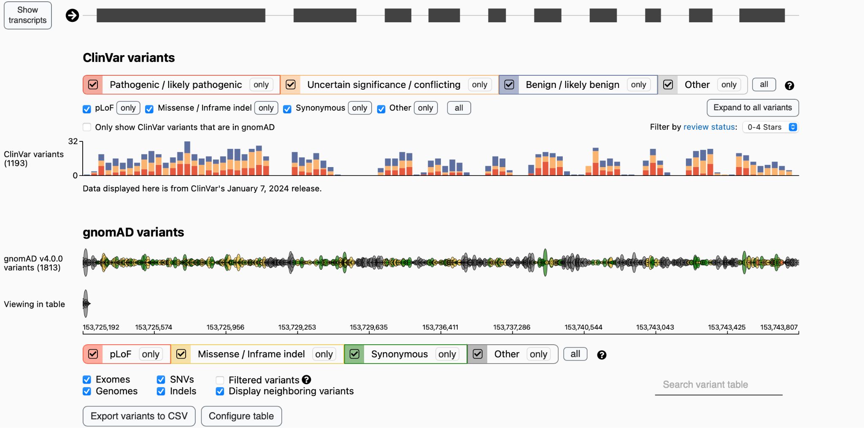
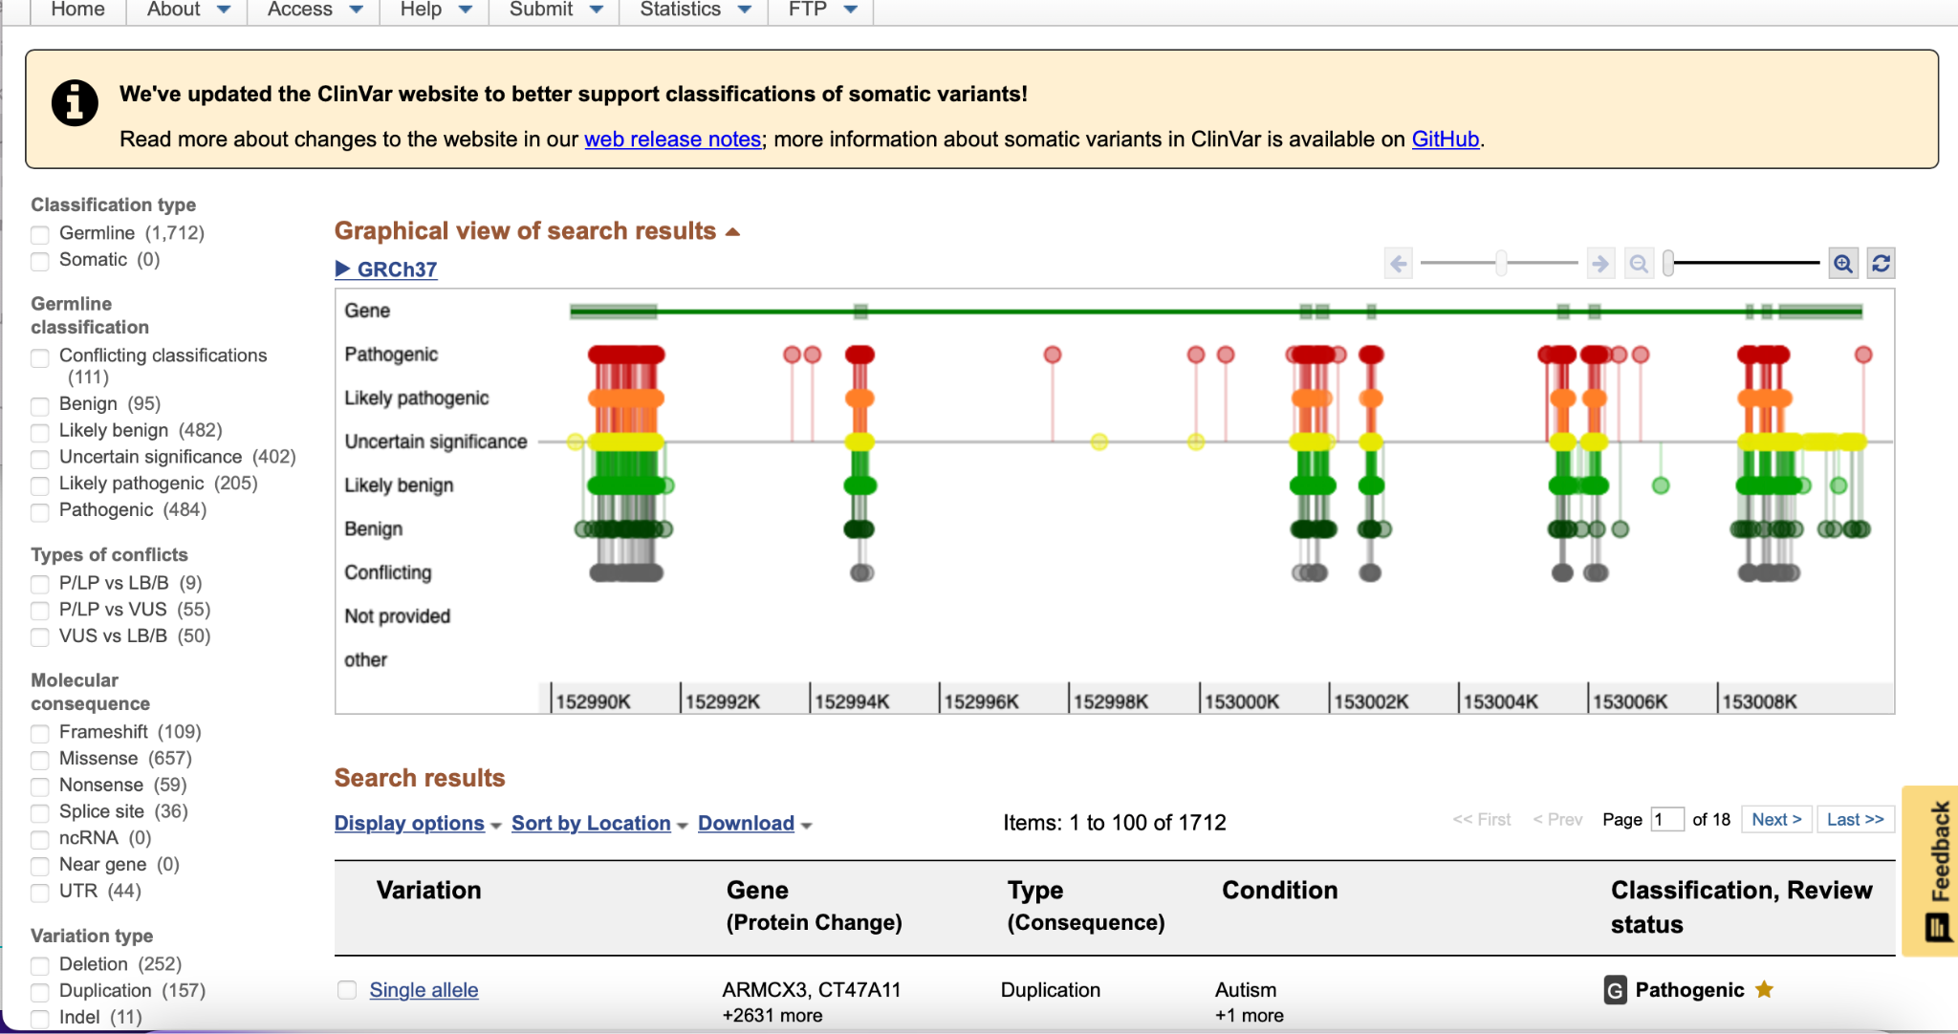
Methods
-Understanding Biological Pathway
-Analyze possible targets
-Propose less invasive new therapeutics

Slide 5
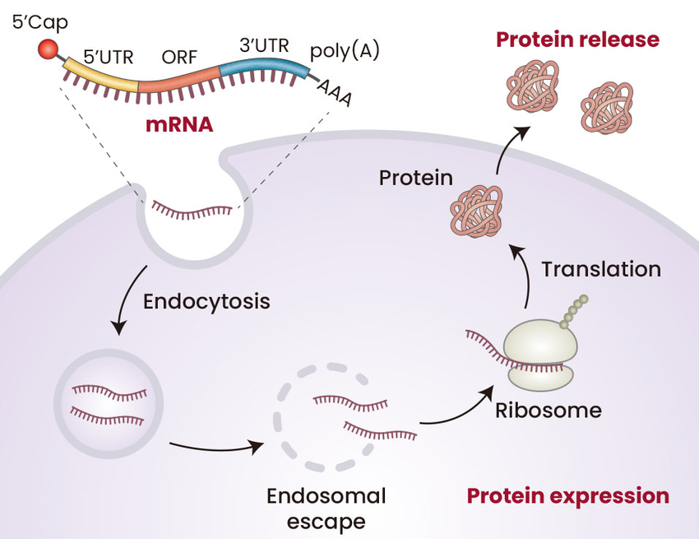
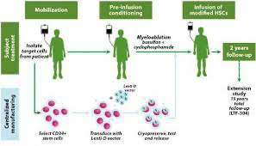
Results
Research Gate
Skysona: The only gene therapy
Home Sunshine Pharmaceutical Technology Co.
Blood Brain Barrier

Slide 6
Discussion
Current Treatment: SkySona Gene Therapy
Lipid nanoparticles for mRNA delivery
Lorenzo’s Oil —--| EVOLV1—->VLCFA

Slide 7
Challenges + future directions
Struggled to find an idea that would work for ALD
Pivoted multiple times (diagnostic website, dataset report, prediction model, etc.)
In the future:
We would start the scope of the project sooner
Test out a few ideas a day or so beforehand to see what works and doesn’t
Solidify idea choice + work on it in a timely fashion before judging
Demyelination, nanoparticle technology immature

Slide 8
References
mRNA therapeutics/vaccines for inducing protein expression.... | Download Scientific Diagram
Rare Diseases.org
OMIM, ABCD1 gene for ALD
OMIM link to ALD characteristics/phenotypes
Drugs. com (Elivaldogene autotemcel)
Skysona: The first gene therapy to treat cerebral adrenal leukodystrophy (CALD)!---2/2 - Knowledge - Hefei Home Sunshine Pharmaceutical Technology Co., Ltd
Pubmed Paper (Long Term Disease Prevention w/Gene Therapy) ALD Connect . org
Public Datasets document
https://pubmed.ncbi.nlm.nih.gov/24489110/

